Slide 1
Oper 655 - IPR
Capt Tyler Spangler

Slide 2
Purpose
Analyze last statements from death row inmates using data set titled “Last Words of Death Row Inmates” found on Kaggle
Perform sentiment analysis of last statements between different convicts to determine if there are factors among convicts that would create more positive or negative last statements
Perform topic modeling to identify common topics in last statements between inmates

Slide 3
Background
Data set includes 545 observations which correspond to individual convicts
Data includes following information on each inmate
Age
Race
County of Conviction
Age When Received
Education Level
Native County
Previous Crime (0 if no previous crime, 1 if previous crime)
Number of Codefendants
Number of Victims
Type of victim (Race and Gender of Victim)
Last Statement
Years in Prison (created by subtracting age when received from age)

Slide 4
Preliminary Analysis
Exploratory Analysis
Used histogram plots to see distribution of convictions across counties, age, race, number of victims, education level, years in prison
Word Relationships
Unnested Words and Trigrams to count top-ten most common words and trigrams for all convicts. Also grouped the counts by race, age, years in prison, education level, and number of victims.
Word Count and Frequency plots for all last statements in backup slide
Determined word frequency for each grouping and for all last statements
Calculated tf_idf for each grouping

Slide 5
Next Steps
Perform sentiment analysis for each last statement to determine if positive or negative and give a score to each convict. Compare sentiment across inmates to determine if there are any similarities between inmate characteristics and the sentiment score.
Perform topic modeling to see range of topics within each last statement and see how they compare across each inmate in the data set.

Slide 6
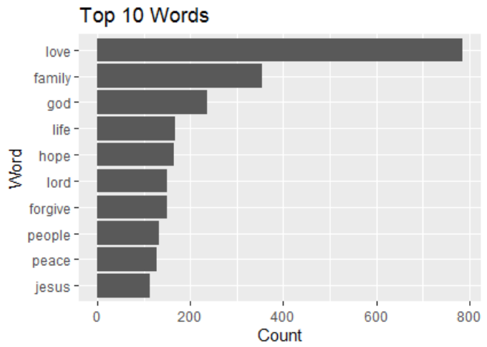
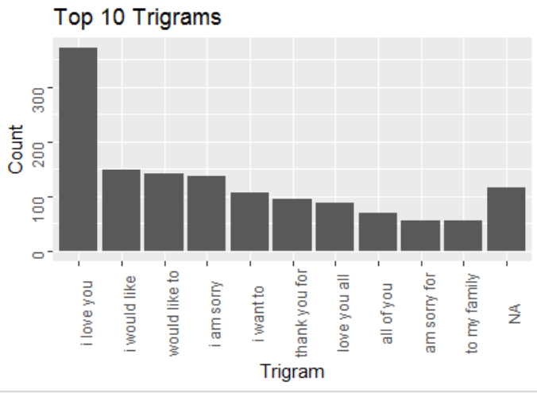
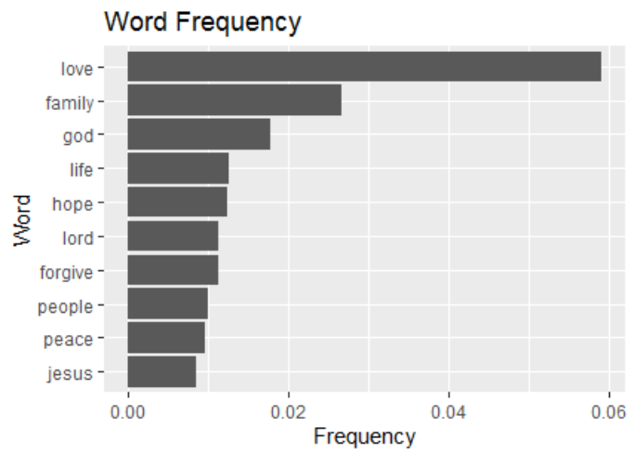
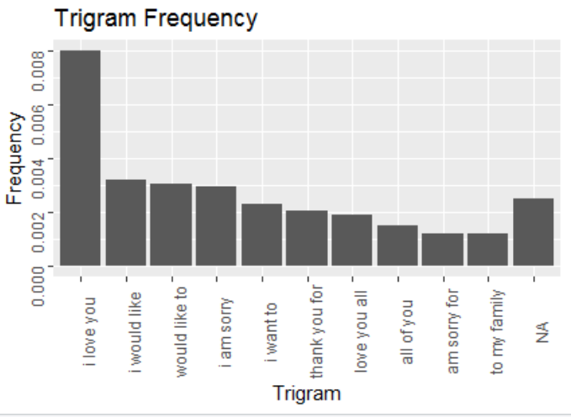
Backup Slide – Plots

